Slide 1
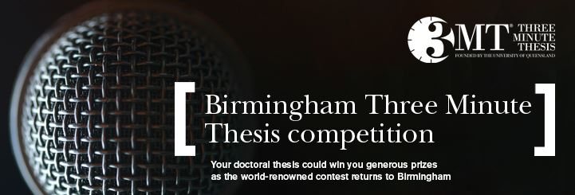

Slide 2

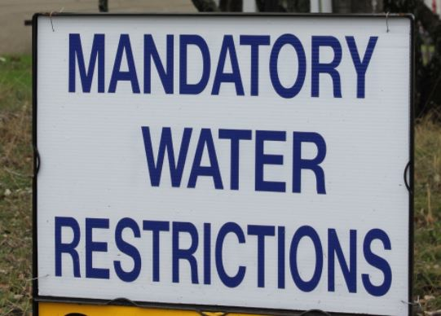

Notes:
To conserve water, residents were encouraged to time their showers, and many people had a 3 min egg timer fixed to the wall in their bathroom. The then Dean of the UQ Graduate School, Emeritus Professor Alan Lawson, put two and two together and the idea for the 3MT competition was born. First competition was in 2008.

Slide 3
The What and Why of 3MT
Effectively explain your research in three minutes, in a language appropriate to a non-specialist audience
Develop skills in:
Presenting and communicating
Public engagement
Raise the profile of your work
Renew your enthusiasm

Slide 4

As with all communication…
…how can we best use this medium to transmit our message to this audience?

Slide 5
What makes a good 3MT?
Simple, easy to follow, few details
Interesting
Engaging style, enthusiasm
Raising awareness of other studies
Clear take home message

Slide 6

Your 3 minute thesis
Slide
Words
Style

Slide 7
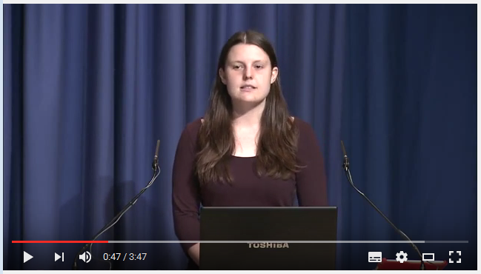

Slide 8
Hayley Keen – 3MT
Slide
Clear slide
Good examples
Graph a mess – no idea what it was about, didn’t understand
Wasted space?
Picture of trees divisive!
Words
Understood what she’s doing, how she’s doing it, what her key results are
Unexplained jargon? Taxa?
Lack of proof for main point?
Style
Speaking fluently
Appears memorised
Terrified!
Appears not to care about project

Slide 9
Your 3 minute thesis
Slide
Words
Style

Slide 10
Your words – the rules
You should present in a style suitable for an intelligent but non-expert audience
ALL presentations should be NO LONGER than three minutes; competitors exceeding three minutes will be disqualified

Slide 11
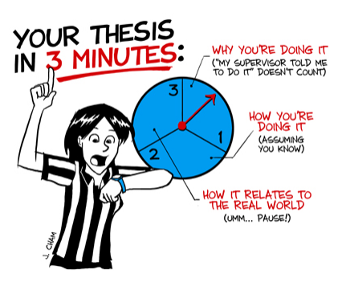

Slide 12
Your words – some guidelines
WHAT – HOW – WHY
Tell a story
Human interest?
Relate to the real world
Be clear about what you’re doing
Non-specialist audience – but intelligent!
Start by assuming 100 words per min

Slide 13
Your turn…
Review (or write) your 3MT script
Read it out to your colleague
Give constructive criticism
Is there unexplained jargon?
Is there a thread/story?
Is it clear what the PhD involves?

Slide 14
Your 3 minute thesis
Slide
Words
Style

Slide 15
Your slide – the rules
You will be allowed one single and static PowerPoint slide to support your presentation (slide transitions or animations are NOT allowed)
No additional electronic media (such as sound or video) are allowed

Slide 16
Your slide – the judging criteria
Enhances the presentation
Clear
Legible
Concise

Slide 17
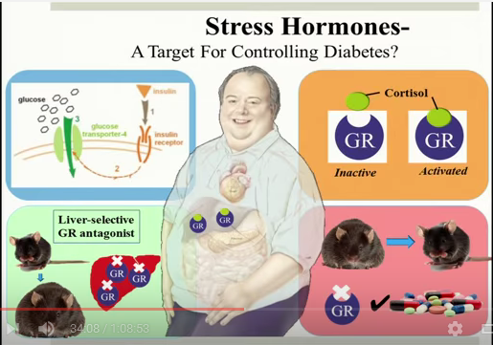
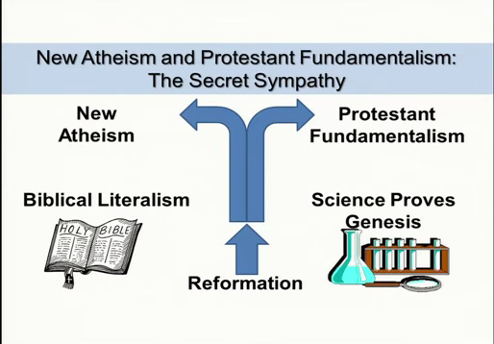
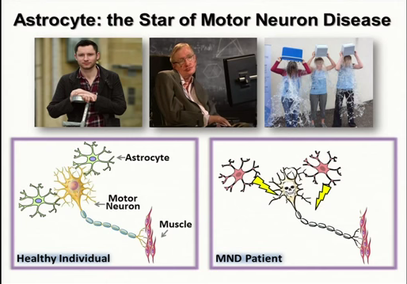
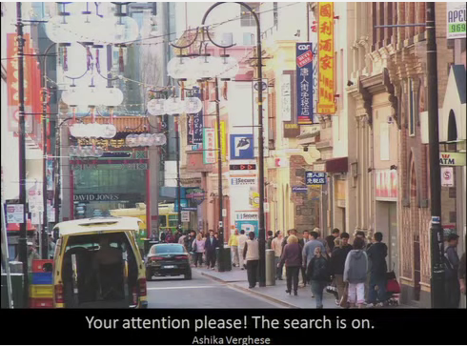
Examples…

Slide 18
Your turn…
Review (or sketch) your slide
Explain how each element enhances your presentation to your colleague
Give constructive feedback
Too busy? Not enough info?
Is it clear?

Slide 19
Your 3 minute thesis
Slide
Words
Style

Slide 20
Your style – the rules
No additional props (e.g. costumes, musical instruments, laboratory equipment) are permitted
No notes are permitted
Presentations are to be spoken word (no poems or songs)

Slide 21
Your style – the judging criteria
Conveys enthusiasm for their research
Captures and maintains the audience's attention
Sufficient stage presence, eye contact and vocal range
Maintains a steady pace
Has a confident stance

Slide 22
Your style - tips
Practice, practice, practice
Find your enthusiasm for your PhD
Love your script
Remember this is the audience’s first time
Use movement and gestures
Believe in yourself

Slide 23
Your 3 minute thesis
Slide
Words
Style
Notes:
Timing / pacing = Words + Style
Effective transfer of information = Words + Slide
Engage audience with your PhD = Words + Slide + Style!

Slide 24
Final thoughts
Read the judging criteria in detail
Check your timing / pacing
ENJOY YOURSELF!

Slide 25
Good luck!

Slide 26
Judging Criteria: Comprehension & Content
Did the presentation provide an understanding of the background to the research question being addressed and its significance?
Did the presentation clearly describe the key results of the research including conclusions and outcomes?
Did the presentation follow a clear and logical sequence?
Was the thesis topic, key results and research significance and outcomes communicated in language appropriate to a non-specialist audience?
Did the speaker avoid scientific jargon, explain terminology and provide adequate background information to illustrate points?
Did the presenter spend adequate time on each element of their presentation - or did they elaborate for too long on one aspect or was the presentation rushed?

Slide 27
Judging Criteria: Engagement & Communication
Did the oration make the audience want to know more?
Was the presenter careful not to trivialise or generalise their research?
Did the presenter convey enthusiasm for their research?
Did the presenter capture and maintain their audience's attention?
Did the speaker have sufficient stage presence, eye contact and vocal range; maintain a steady pace, and have a confident stance?
Did the PowerPoint slide enhance the presentation - was it clear, legible, and concise?

